Slide 1
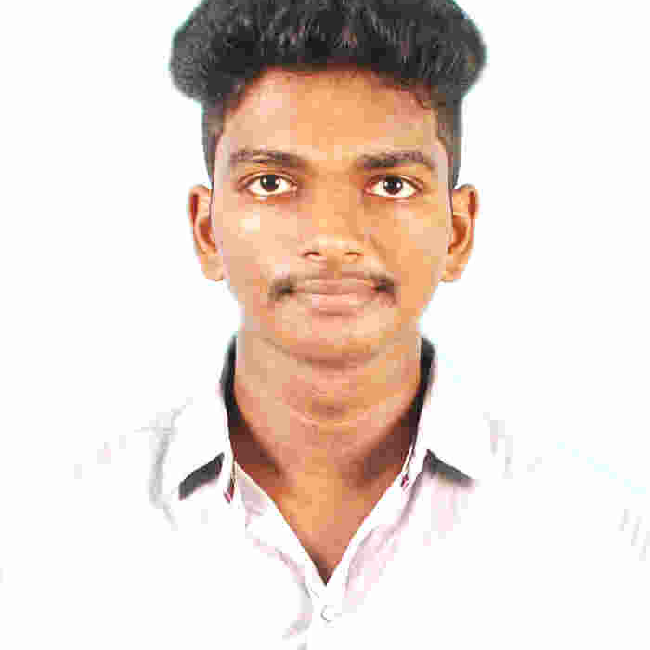



Sudesh Kamalanathan
Analyst/Software Engineer
Bachelor of Engineering, Computer Science and Engineering : 2016 - 2020
Skills
Bangalore
C# | C# Basics,OOPS,Generics, Collections, Array,Loops,LINQ
.NET | ADO.NET,ASP.NET with MVC5 and WEB API,Entity Framework
Angular | Components, Services, Modules, Routing, Forms & Validation
Database | Microsoft SQL Server
UI Tech | HTML 5 & CSS 3,JavaScript, ES6 & TypeScript ,Optimized UI Designed,Bootstrap
Tools | Git, PostMan,SSMS,Visual Studio, Visual Studio Code
Add On skills | Immersive Learning
sudesh.kamalanathan@capgemini.com
+91 9789894419
A4
Full Stack Developer
Hands on experience on C#,ADO.NET,LINQ,Entity framework,Sql Server,ASP.NET MVC5 with WEB API
Full Stack developer with Angular and Full Stack .NET Developer
Done Microsoft .Net Immersive training under iTransform learning program and Azure az900
Proficient in creating Single page Web Application in Angular with Authentication with routing.
Hands on experience in developing web pages using HTML5, CSS3, Object Oriented Java script, TypeScript, ES6, JSON, XML. Good understanding of Document Object Model (DOM) and DOM Functions.
Knowledge on SSMS and Git
Car Wash Management System [ Video Profile]
Case study of Car Wash Management System along with API Gateway, Swagger and payment , responsive UI with HTML5, CSS, Bootstrap and Angular used as User Interface.
Check out my work on GitHub

